Slide 1
Curiosity Booster Overview of NoSQL and MongoDB

Slide 2
What is NoSQL Database ?
Not only SQL database.
Provides a mechanism for storage and retrieval of data that is modelled in means other than the tabular relations. (e.g. key-value, graph, or document)
NoSQL is also about being open and aware of alternative, existing and additional patterns and tools for managing your data(Hadoop for data processing and Redis for persistence lookup). Increasingly used in big data and real time web applications.
Motivations for this approach include simplicity of design, horizontal scaling and finer control over availability; Making some operations faster in NoSQL and others faster in relational databases
Where does MongoDB fits into all of this: MongoDB is an open source document-oriented NoSQL solution. Other alternatives for NoSQL solution are Cassandra, CouchDB, Riak, Hbase etc.

Slide 3
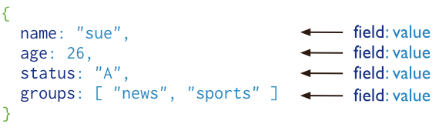
Introduction to MongoDB
A record in MongoDB is a document, which is a data structure composed of key and value pairs. It is basic unit of data in MongoDB.
A collection is a grouping of MongoDB documents. A collection is the equivalent of an RDBMS table. Collections do not enforce a schema.
A database is a physical container for collections. Each database gets its own set of files on the file system.

Slide 4
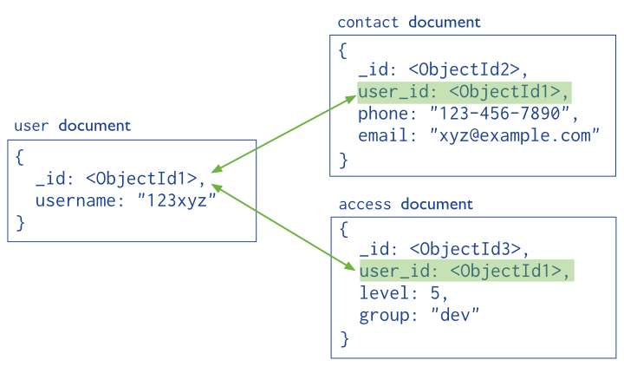
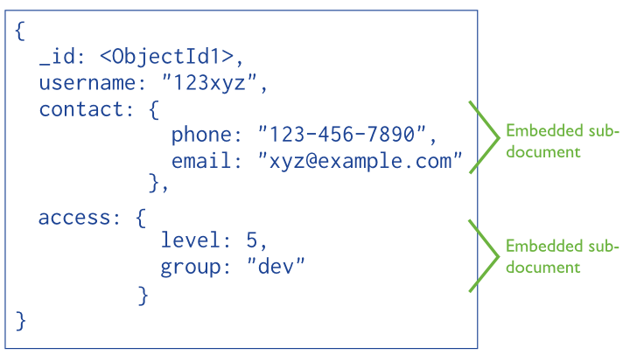
Mongo Data Modelling
Data in MongoDB has a flexible schema. Unlike SQL databases, where you must determine and declare a table’s schema before inserting data, MongoDB’s collections do not enforce document structure.
Key parameters for decision making of Data Modelling:
Data retrieval patterns (i.e. queries, updates, and processing of the data)
inherent structure of the data (document)
Document Structure:
Referenced document | Embedded document

Slide 5
Setup and Practical Demo
For download visit https://www.mongodb.org/downloads
Guide for installation : http://docs.mongodb.org/manual/tutorial/install-mongodb-on-windows/
Set up the MongoDB environment: MongoDB requires a data directory to store all data. MongoDB’s default data directory path is \data\db.
Start MongoDB, run mongod.exe from command prompt. (This can also be started as Windows service)
Open another Command Prompt, To connect to MongoDB as client through the mongo.exe shell.
Mongo.exe vs mongod.exe :Both the mongod (database server) and mongo (database client shell) programs are command line programs and each expects to be run in its own command line session. mongod.exe is the build of the MongoDB daemon (i.e. mongod) for the Windows platform. mongo.exe is the shell which is used to write mongoDB queries in console based format.

Slide 6
Setup and Practical Demo (cont.)
Example:
Basic CRUD operations (http://docs.mongodb.org/v3.0/tutorial/getting-started-with-the-mongo-shell/)
DataTypes and Queries (Searching and Sorting)
Aggregation (Computed queries)
Mongoose : mongodb object modeling for node.js (http://mongoosejs.com/)

Slide 7
Comparison of various MongoDB related tools
Mongo Management Studio: Professional/Enterprise Edition (Also comes in community edition which is free. Mongo Management Studio is a management console for MongoDB. With a clean and lightweight user interface, you can execute the typical MongoDB commands, without using the MongoDB shell. It cant assists your local development and test processes. With a basic but strict user and rights management you can control of the access rights of all users.
Robo Mongo: is a shell-centric cross-platform open source MongoDB management tool (i.e. Admin GUI). Robomongo embeds the same JavaScript engine that powers MongoDB’s mongo shell. Everything you can write in mongo shell you can write in Robomongo!
MongoVUE: is an innovative MongoDB desktop application for Windows OS that gives you an elegant and highly usable GUI interface to work with MongoDB. Mongovue has been around for a while and is solid and affordable. The best feature is that for a given database we can see just how much space everything is using and how your data is growing.

Slide 8
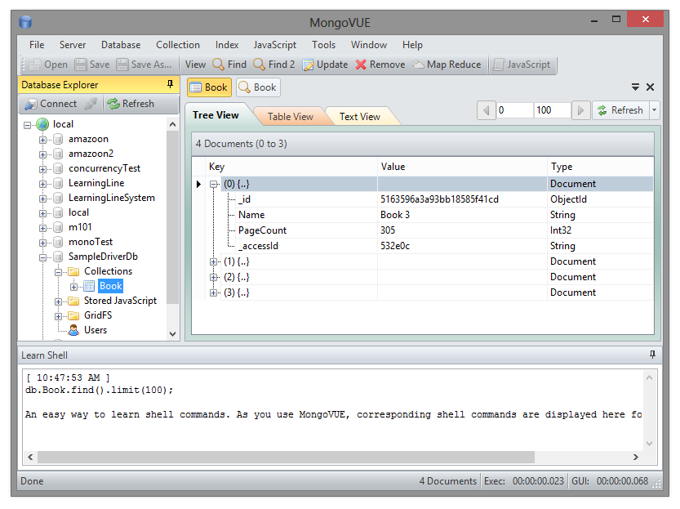
MongoVUE

Slide 9
Advanced topics for self-study.
MongoDB related tools : http://docs.mongodb.org/ecosystem/tools/administration-interfaces/
Is MongoDB Candidate for Big Data/ Its relation with IOT: http://en.wikipedia.org/wiki/Big_data
Deployment notes: https://blog.serverdensity.com/notes-from-a-production-mongodb-deployment/
Administration (Monitoring and Diagnostics): http://docs.mongodb.org/manual/administration/monitoring/
Security and Authentication: http://docs.mongodb.org/manual/core/security-introduction/
Indexes : http://docs.mongodb.org/manual/core/indexes-introduction/
Replication and Sharding : http://docs.mongodb.org/manual/core/replication-introduction/
Scaling/ Partitioning/ Clustering

Slide 10
References:
http://docs.mongodb.org/manual/core/introduction/
http://en.wikipedia.org/wiki/NoSQL
http://code.tutsplus.com

Slide 11
Thank you!! Ankit Arora

